Slide 1
HASH SET

Slide 2
What is HashSet<T> Collection
The Generic HashSet<T> Collection Class in C# can be used to store, remove or view elements. It is an unordered collection of unique elements. It does not allow for the addition of duplicate elements. So, it is recommended to use the HashSet collection if you want to store only unique elements. This collection is of the generic type collection and hence it belongs to System.Collections.Generic namespace. The performance of the HashSet is much better in comparison to the list collection in C#.

Slide 3
How to create a Generic HashSet Collection in C#?
The Generic HashSet Collection class in C# provided seven constructors that we can use to create an instance of HashSet. They are as follows:
public HashSet(): It initializes a new instance of the System.Collections.Generic.HashSet class that is empty and uses the default equality comparer for the set type.
public HashSet(IEnumerable<T> collection): It initializes a new instance of the System.Collections.Generic.HashSet class that uses the default equality comparer for the set type, contains elements copied from the specified collection and has sufficient capacity to accommodate the number of elements copied.
public HashSet(IEqualityComparer<T> comparer): It initializes a new instance of the System.Collections.Generic.HashSet class that is empty and uses the specified equality comparer for the set type.
public HashSet(int capacity): It initializes a new instance of the System.Collections.Generic.HashSet class that is empty, but has reserved space for capacity items and uses the default equality comparer for the set type.
public HashSet(IEnumerable<T> collection, IEqualityComparer<T> comparer): It initializes a new instance of the System.Collections.Generic.HashSet class that uses the specified equality comparer for the set type, contains elements copied from the specified collection and has sufficient capacity to accommodate the number of elements copied.
public HashSet(int capacity, IEqualityComparer<T> comparer): It initializes a new instance of the System.Collections.Generic.HashSet class that uses the specified equality comparer for the set type, and has sufficient capacity to accommodate capacity elements.
protected HashSet(SerializationInfo info, StreamingContext context): It initializes a new instance of the System.Collections.Generic.HashSet class with serialized data.

Slide 4
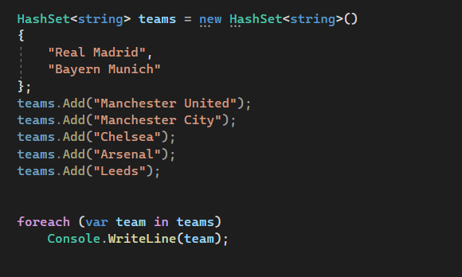
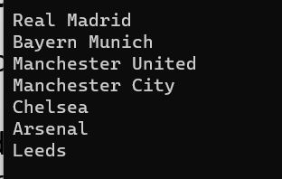
How to Add/Access Elements into a HashSet Collection
If you want to add elements to your HashSet Collection, then you need to use the following Add() method of the HashSet class.
Add(T item): This method is used to add the specified element to a set. The parameter item specifies the element to add to the set. It returns true if the element is added to the System.Collections.Generic.HashSet object; false if the element is already present.

Slide 5
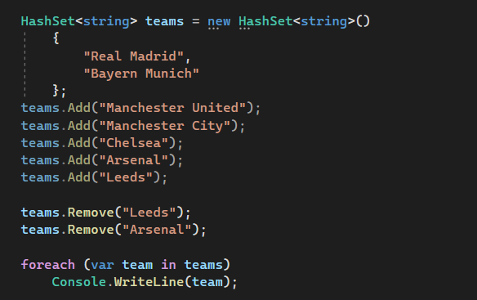
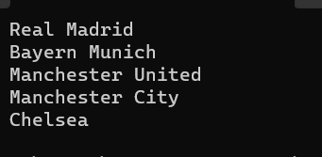
How to Remove Elements from a Generic HashSet<T> Collection
The Generic HashSet<T> Collection Class in C# provides the following three methods to remove elements from the HashSet.
Remove(T item): This method is used to remove the specified element from a HashSet object. Here, the parameter item specifies the element to remove. It returns true if the element is successfully found and removed; otherwise, false. This method returns false if the item is not found in the System.Collections.Generic.HashSet object.
RemoveWhere(Predicate<T> match): This method is used to remove all elements that match the conditions defined by the specified predicate from a HashSet collection. It returns the number of elements that were removed from the HashSet collection. Here, the parameter match specifies the Predicate delegate that defines the conditions of the elements to remove.
Clear(): This method is used to remove all elements from a HashSet object.

Slide 6
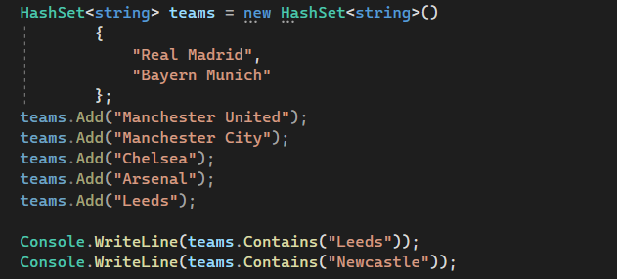

How to Check the Availability of an Element in a HashSet
If you want to check whether an element exists or not in the HashSet, then you can use the following Contains() method of the HashSet class.
public bool Contains(T item): This method is used to determine whether a HashSet object contains the specified element. The parameter item specifies the element to locate in the HashSet object. It returns true if the HashSet object contains the specified element; otherwise, false.

Slide 7
Set Operations on Generic HashSet<T> Collection Class
The Generic HashSet Collection Class in C# also provides some methods that we can use to perform different set operations. The methods are as follows.
UnionWith(IEnumerable<T> other): This method is used to modify the current HashSet object to contain all elements that are present in itself, the specified collection, or both. Here, the parameter other specifies the collection to compare to the current HashSet object. If the parameter other is null, then we will get ArgumentNullException.
IntersectWith(IEnumerable<T> other): This method is used to modify the current HashSet object to contain only elements that are present in that object and in the specified collection. Here, the parameter other specifies the collection to compare to the current HashSet object. If the parameter other is null, then we will get ArgumentNullException.
ExceptWith(IEnumerable<T> other): This method is used to remove all elements in the specified collection from the current HashSet object. Here, the parameter other specifies the collection of items to remove from the HashSet object. If the parameter other is null, then we will get ArgumentNullException.
SymmetricExceptWith(IEnumerable<T> other): This method is used to modify the current HashSet object to contain only elements that are present either in that object or in the specified collection, but not both. Here, the parameter other specifies the collection to compare to the current HashSet object. If the parameter other is null, then it will throw ArgumentNullException

Slide 8
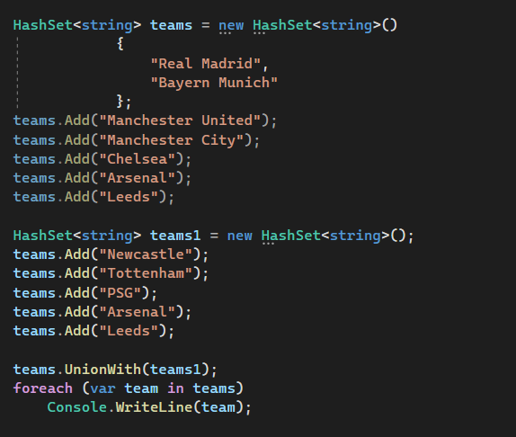
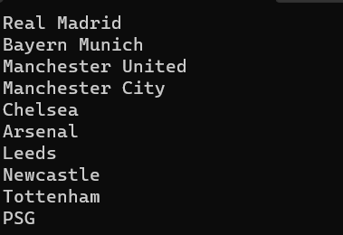
HashSet UnionWith(IEnumerable<T> other)
The UnionWith method contains all the elements which are present in both the collection while removing the duplicate elements.

Slide 9
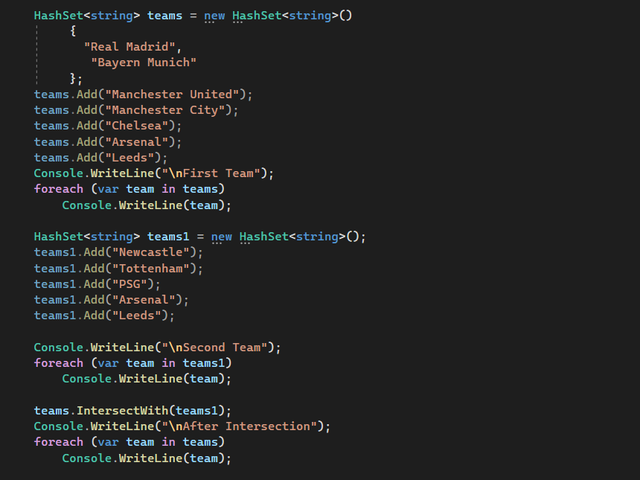
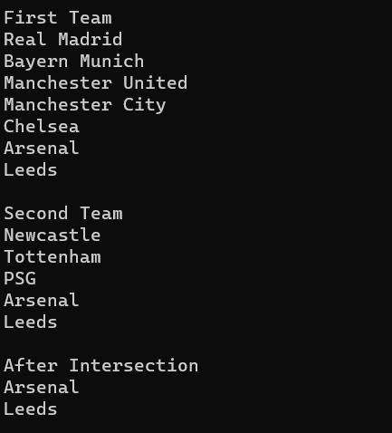
HashSet IntersectWith(IEnumerable<T> other)
The IntersectWith method of the Generic HashSet Collection Class contains the common elements which are present in both the collection.

Slide 10
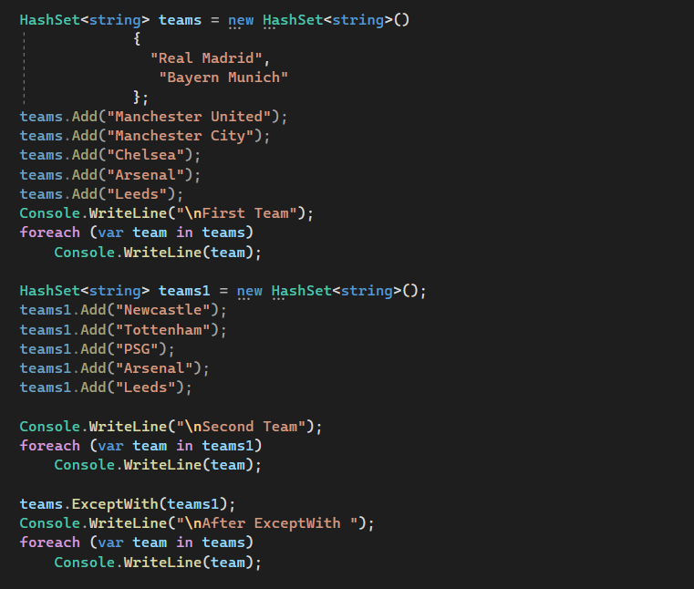
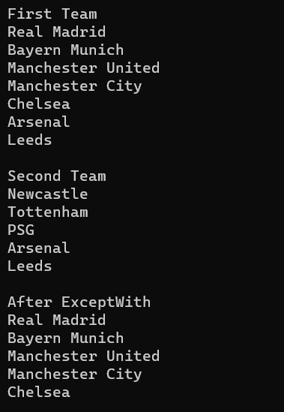
HashSet ExceptWith(IEnumerable<T> other)
The ExceptWith method of the Generic HashSet Collection Class contains the elements from the first collection which are not present in the second collection

Slide 11
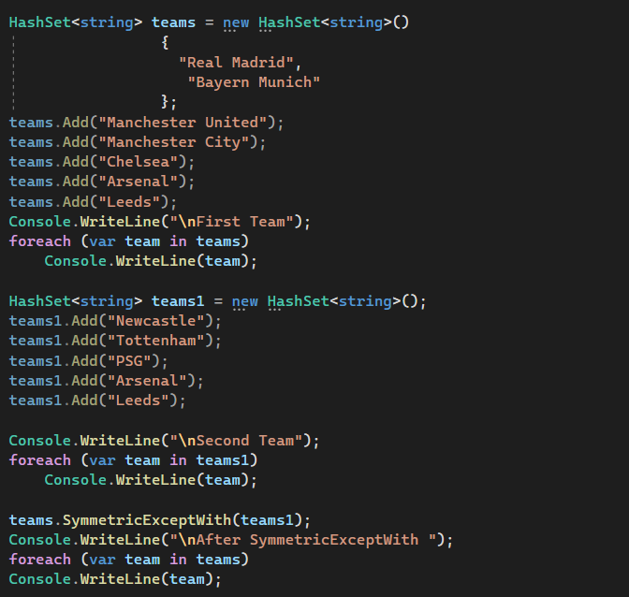
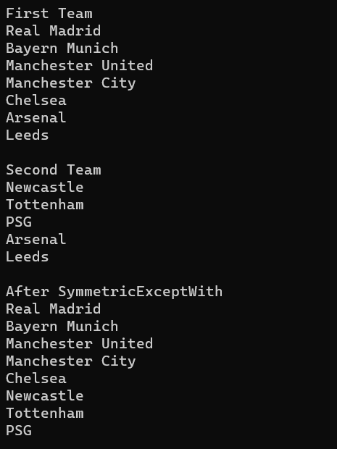
HashSet SymmetricExceptWith(IEnumerable<T> other)
The SymmetricExceptWith method contains elements that are not common in both collections.

Slide 12
Generic HashSet<T> Collection Class Summary:
The Generic HashSet<T> Collection Class implements the ICollection<T>, IEnumerable<T>, IEnumerable, IReadOnlyCollection<T>, ISet<T>, IDeserializationCallback, ISerializable interfaces.
It is an unordered collection and hence we cannot sort the elements of HashSet as the order of the element is not defined
It does not allow the addition of duplicate elements i.e. the elements must be unique in HashSet.
The Generic HashSet<T> Collection provides many mathematical set operations, such as intersection, union, and difference.
The capacity of a HashSet collection is the number of elements it can hold.
The Generic HashSet <T> in C# is a dynamic collection. That means the size of the HashSet is automatically increased when new elements are added to the collection.
As the HashSet <T> is a Generic Collection, so we can only store the same type of elements.

